Slide 1
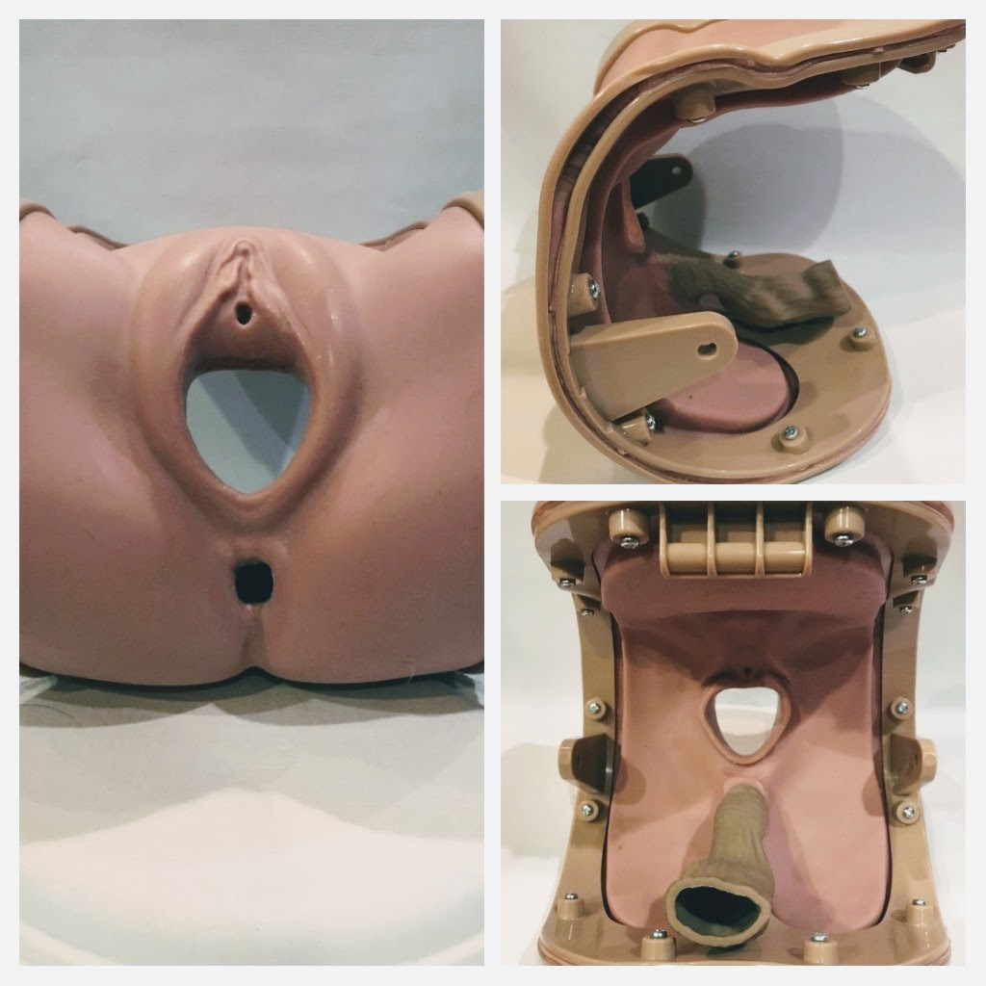
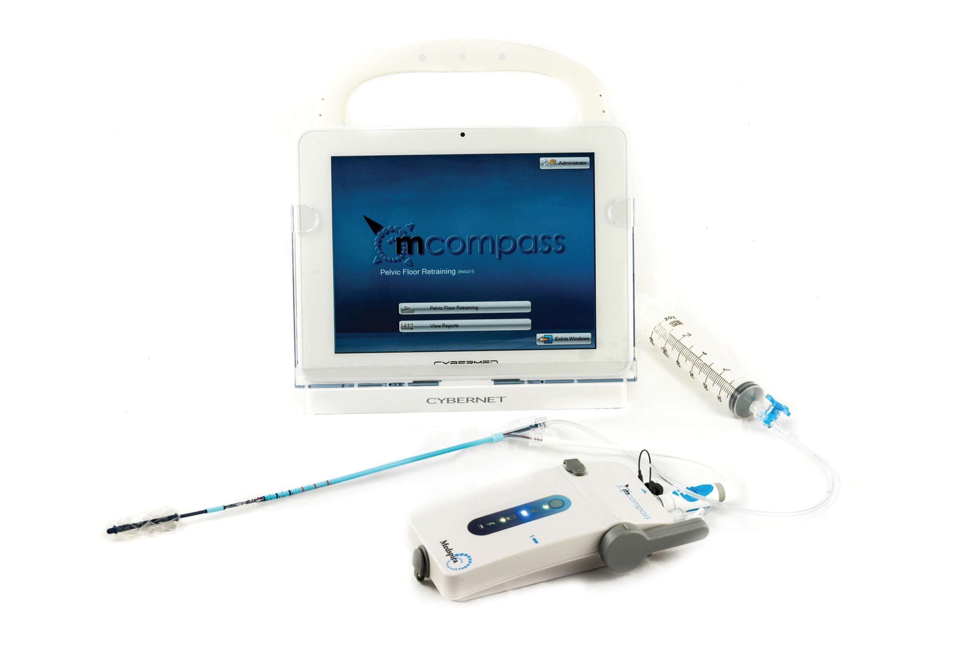
Anorectal Manometry Testing Effectively Trained in Less than three Hours – A Pilot Study
Daniel Stone, MD & Mikio Nihira, MD, MPH
OBJECTIVE: The aim of this investigation was to learn if a standardized training process that included recorded didactics followed by simulated practice of ARM on a mannequin could train pelvic floor providers to perform ARM on a standardized patient (SP).
RESULTS: Five pelvic floor providers were recruited for training: one FPMRS surgeon that had received ARM training as a fellow, two FPMRS OB/GYN fellows (PGY IV & VII with no prior ARM training), one FPMRS PT (No prior ARM training) and a gastroenterologist faculty that received ARM training as a fellow. All providers successfully performed ARM on a SP the following day. Immediately after training, providers completed Visual Analog Scales (VAS) to document effectiveness of the training process (10 mm defined the highest level of confidence or perceived performance). Mean VAS scores were: Level of efficacy of the hands-on experience, 94.9 mm; Level of ability to independently perform each subcomponent of testing: 87.4 mm; Likelihood of incorporating the testing into your practice: 76.4 mm mean distance. One provider (FPMRS PT) was found to be an outlier in 2/3 of the survey questions. When only measuring mean VAS scores for physicians the scores were 94.6, 93.5, and 94.8 mm respectively – indicating that the physician providers had a high degree of confidence in their ability to perform ARM independently. All four of the physician providers were assessed as requiring “passive assistance” or less during ARM performance on the SP.
METHODS: The Mcompass® ARM (Medspira, Minneapolis, MN) is a portable instrument that employs disposable, air-charged catheters. Device software systematically guides operators through the Anorectal Manometry (ARM) process during testing. A convenience sample of pelvic floor providers were recruited for training. All providers viewed the 5 instructional videos that trained: use of MCOMPASS software, assembly and calibration of the ARM instrumentation, catheter insertion and performance of ARM procedure and how to create a summary report of the ARM findings. Subsequently the providers were invited to practice and perform the procedure on a mannequin. Following didactic and simulated training, the providers performed ARM on a standardized patient. A manufacturer’s representative was present during the ARM. Following performance of ARM all providers completed instruments that anonymously assessed perceptions of the: 1) efficacy of the didactic training experience, 2) efficacy of the simulation, and 3) ability to independently perform each subcomponent of ARM. The representative then commented on the level of supervision required to complete the ARM.
Figure 2. Miyazaki Model
External genitalia, anus and rectum (vagina and viscera removed)
Employed for simulation training.
Conclusion: A brief standardized didactic curriculum followed by simulated practice successfully trained a heterogeneous group of FPMRS providers to employ a novel ARM device. The learners perceived training to be efficient, and helpful in training them to perform ARM independently.
Figure 1. Medspira Mcompass® ARM system including the touch-screen display, blue-tooth enabled pressure-transducer and disposable catheter
Figure 2. Survey questions given at the end of training with corresponding results

